Slide 1

THE NATIONAL INSTITUTE OF ENGINEERING MYSORE Autonomous Institue Affliated to VTU Department of Electronics and communication Engineering MINOR PROJECT PHASE -2 PRESENTATION ON “Implementation of Y86-64 processor architetecture design using hardware coding language VERILOG “
Guided by :
Dr. Narasimha kaulgud
Professor
Department Of ECE
NIE MYSORE

Slide 2
Sequential Y86-64 Implementations
Stages in Y86-64
Fetch
Decode
Execute
Memory
WriteBack
PC update

Slide 3
1.Fetch
Algorithm for fetch Module
Check for Memory Error:
If the PC value exceeds the memory boundary (e.g., 1023 in this case), set mem_error to 1 and exit.
Decode Instruction:
Extract the icode and ifun from the instr bits.
Calculate Next PC (valP):
Determine the next PC value based on the icode:
For icode values 0000, 1001, 0001: valP = PC + 1
For icode values 0010, 0110, 1010, 1011: valP = PC + 2
For icode values 0011, 0100, 0101: valP = PC + 10
For icode values 0111, 1000: valP = PC + 9
Extract Operands (if applicable):
Based on the icode:
Extract rA and rB from the instr bits if applicable.
Extract valC from the instr bits if applicable.
Set instr_error:
If the icode value is not recognized, set instr_error to 1.

Slide 4
2.Decode
Algorithm for Decode Stage
Initialize:
Set valA and valB to 0.
Decode Instruction:
Check the value of icode:
If icode is 6 (opq):
Set valA to the value of register rA.
Set valB to the value of register rB.
If icode is 2 (cmovxx):
Set valA to the value of register rA.
Set valB to 0.
If icode is 4 (rmmov):
Set valA to the value of register rA.
Set valB to the value of register rB.
If icode is 5 (mrmov):
Set valB to the value of register rB.
If icode is 10 (push A):
Set valA to the value of register rA.
Set valB to the value of register 4 (assuming %rsp is in register 4).

Slide 5
If icode is 11 (pop B):
Set valA to the value of register 4 (assuming %rsp is in register 4).
Set valB to the value of register 4 (assuming %rsp is in register 4).
If icode is 8 (call):
Set valB to the value of register 4 (assuming %rsp is in register 4).
If icode is 9 (ret):
Set valA to the value of register 4 (assuming %rsp is in register 4).
Set valB to the value of register 4 (assuming %rsp is in register 4).

Slide 6
3.Execute
Algorithm for Execute Stage
Calculate Condition Flag (cnd):
If icode is 2 (cmovxx) or 7 (jxx):
Determine the cnd value based on the ifun and the current flags (zf, sf, of):
ifun = 0000 (uc): cnd = 1 (unconditional)
ifun = 0001 (le): cnd = (sf ^ of) | zf
ifun = 0010 (l): cnd = of ^ sf
ifun = 0011 (e): cnd = zf
ifun = 0100 (ne): cnd = ~zf
ifun = 0101 (ge): cnd = ~(sf ^ of)
ifun = 0110 (g): cnd = ~(sf ^ of) & ~zf
Otherwise, set cnd to 0.
Perform ALU Operations:
Based on the icode:
If icode is 2 (cmovxx):
Perform the ALU operation for cmovxx (e.g., pass valA to valE_cmov).
If icode is 3 (irmov), 4 (rmmov), or 5 (mrmov):
Perform the ALU operation for memory moves (e.g., pass valC to valE_cb).

Slide 7
If icode is 6 (opq):
Perform the ALU operation specified by ifun on valA and valB and store the result in valE_op.
Calculate cf_out based on the result of the ALU operation:
Set cf_out[0] (zero flag) to 1 if valE_op is 0, otherwise 0.
Set cf_out[1] (sign flag) to the value of the most significant bit of valE_op.
Set cf_out[2] (overflow flag) to the value of overflow_use from the ALU operation.
If icode is 8 (call) or 10 (push A):
Perform the ALU operation for stack decrement (e.g., subtract 8 from valB and store the result in valE_sd).
If icode is 9 (ret) or 11 (pop B):
Perform the ALU operation for stack increment (e.g., add 8 to valB and store the result in valE_si).
Select Output (valE):
Based on the icode:
If icode is 2 (cmovxx): valE = valE_cmov
If icode is 3 (irmov), 4 (rmmov), or 5 (mrmov): valE = valE_cb
If icode is 6 (opq): valE = valE_op
If icode is 8 (call) or 10 (push A): valE = valE_sd
If icode is 9 (ret) or 11 (pop B): valE = valE_si
Otherwise, valE = 0

Slide 8
4.Memory
Algorithm for Memory Stage
Data Memory Access:
Based on the icode:
If icode is 4 (rmmov) or 10 (pushq):
Store the value of valA in the memory location specified by valE.
If icode is 5 (mrmov):
Load the value from the memory location specified by valE into valM.
If icode is 11 (popq):
Load the value from the memory location specified by valA into valM.
If icode is 8 (call):
Store the value of valP (next instruction address) in the memory location specified by valE.
If icode is 9 (ret):
Load the value from the memory location specified by valA into valM.
(Optional) Data Memory Initialization:
For debugging or testing purposes, you can initialize specific memory locations with predefined values. The example code initializes location valA with 200 and location valE with 100.

Slide 9
5. WRITE BACK
Algorithm for write_back Stage
Update Register File:
On the negative edge of the clock:
Load the input register values (reg_in0 to reg_in14) into the internal register file (reg_file).
Based on the icode:
If icode is 6 (opq), 2 (cmovxx), or 3 (irmov):
Write the value of valE to the register specified by rB.
If icode is 11 (popq):
Write the value of valE to register 4 (%rsp).
Write the value of valM to the register specified by rA.
If icode is 8 (call), 9 (ret), or 10 (pushq):
Write the value of valE to register 4 (%rsp).
If icode is 5 (mrmov):
Write the value of valM to the register specified by rA.
Output Register Values:
Assign the values from the internal register file (reg_file) to the output ports (reg_out0 to reg_out14).

Slide 10
6.PC_Upadte
Algorithm for Pc update Module
On the Positive Edge of the Clock:
Based on the icode:
If icode is 0000: Set pcnxt to 0.
If icode is 0111 (jxx):
If cnd is 1 (condition is true): Set pcnxt to valC (jump target).
Otherwise, set pcnxt to valP (next instruction address).
If icode is 1000 (call): Set pcnxt to valC (call target).
If icode is 1001 (ret): Set pcnxt to valM (return address).
For all other icode values: Set pcnxt to valP (next instruction address).

Slide 11
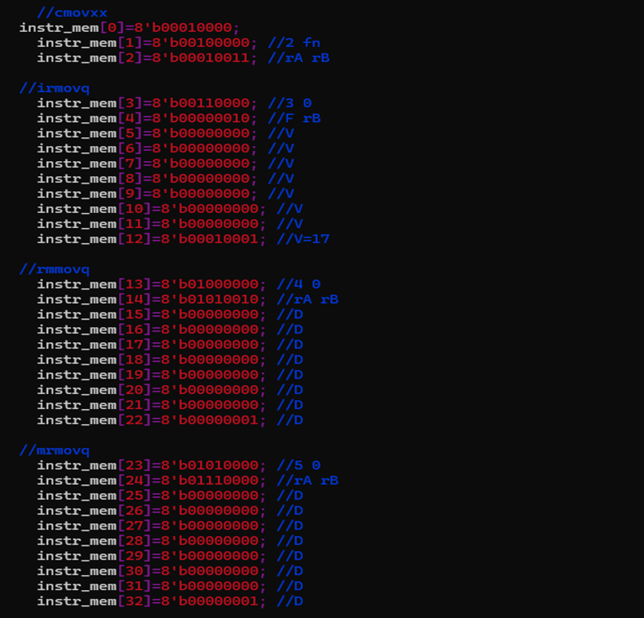
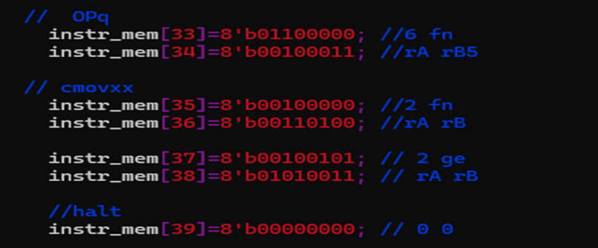
Testbench Instructions

